Slide 1

First django app part - 1
Django Mastery Course

Slide 2
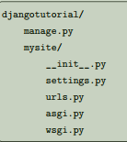
1. Creating a project
First create a project by [django-admin startproject project name] add [.] in the end to make the project in the current directory without the main root directory .
File structure:
These files are:
• manage.py: A command-line utility that lets you interact with this Django project in various ways.
You can read all the details about manage.py in django-admin and manage.py.
• mysite/: A directory that is the actual Python package for your project. Its name is the Python package
name you’ll need to use to import anything inside it (e.g. mysite.urls).
• mysite/__init__.py: An empty file that tells Python that this directory should be considered a
Python package. If you’re a Python beginner, read more about packages in the official Python docs.
• mysite/settings.py: Settings/configuration for this Django project. Django settings will tell you all
about how settings work.
• mysite/urls.py: The URL declarations for this Django project; a “table of contents” of your Django
powered
site. You can read more about URLs in URL dispatcher.
• mysite/asgi.py: An entry-point for ASGI-compatible web servers to serve your project.
• mysite/wsgi.py: An entry-point for WSGI-compatible web servers to serve your project.
2. Run the development server
Command for running server: [python manage.py runserver]

Slide 3
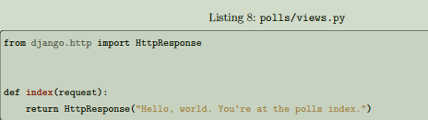
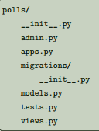
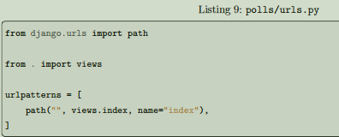
Creating the Polls app
What’s the difference between a project and an app? An app is a web application that does something – e.g., a blog system, a database of public records or a small poll app. A project is a collection of configuration and apps for a particular website. A project can contain multiple apps. An app can be in multiple projects.
Use this command: [python manage.py startapp app_name]
App Directory:-
Writing the view
This is the most basic view possible in Django. To access it in a browser, we need to map it to a URL - and for this we need to define a URL configuration, or “URLconf” for short. These URL configurations are defined inside each Django app, and they are Python files named urls.py. To define a URLconf for the polls app, create a file polls/urls.py with the following content:

Slide 4
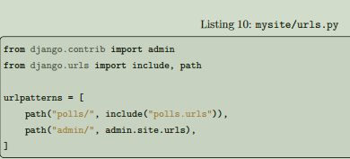
The next step is to configure the root URLconf in the mysite project to include the URLconf defined in polls. urls. To do this, add an import for django.urls.include in mysite/urls.py and insert an include() in the urlpatterns list, so you have:
The path() function expects at least two arguments: route and view. The include() function allows referencing other URLconfs. Whenever Django encounters include(), it chops off whatever part of the URL matched up to that point and sends the remaining string to the included URLconf for further processing.
Now run the server and visit in the:
http://localhost:8000/polls/

Slide 5

Thank you for watching
💖

